Slide 1
VOLTAGE REGULATION AND EFFICIENCY OF TRANSFORMER

Slide 2
Voltage Regulation
The voltage regulation is defined as the change in the magnitude of receiving and sending voltage of the transformer.
The voltage regulation determines the ability of the transformer to provide the constant voltage for variable loads.
The electrical equipments are designed to be operated at a certain voltage.
A tolerance limit is provided so that equipment may operate between this range.
Transformers connect equipments and machines to the supply. If the terminal voltage drops too low below the rated value due to the load currents, it may affect the performance of the equipments. This is not desirable.
It is therefore important to specify and quantify that there is a voltage drop when certain load current is taken up from the transformer.

Slide 3


Voltage regulation is quantified using two terms:
a. Regulation down
b. Regulation up
Regulation Down
Regulation down is the change in terminal voltage when a load current at any power factor is applied, expressed as a fraction of the no-load terminal voltage.
Where, V_{nl =} no-load terminal voltage V_{l} = load terminal voltage
Regulation Up
Regulation up is the ratio of the change in the terminal voltage when a load at a given power factor is removed, and the load voltage.
Where, V_{nl} = no-load terminal voltage. V_{l} = load voltage.

Slide 4
Efficiency of Transformer
Just like any other electrical machine, efficiency of a transformer can be defined as the output power divided by the input power.
i.e. efficiency = output / input .
Transformers are the most highly efficient electrical devices.
Most of the transformers have full load efficiency between 95% to 98.5% .
As a transformer being highly efficient, output and input are having nearly same value, and hence it is impractical to measure the efficiency of transformer by using output / input.
A better method to find efficiency of a transformer is using,
efficiency = (input - losses) / input
= 1 - (losses / input).

Slide 5
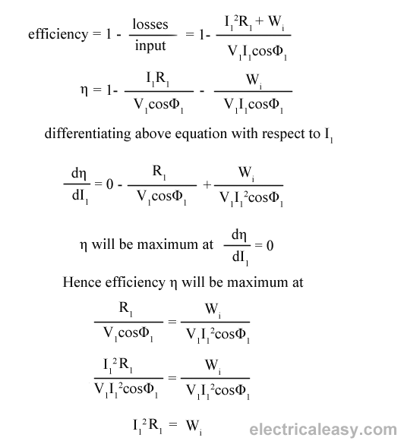
Condition for maximum efficiency
Let, Copper loss = I₁²R_{1 ,}
Iron loss = Wi
Hence,
efficiency of a transformer will be maximum when copper loss and iron losses are equal. That is Copper loss = Iron loss.

Slide 6


All day efficiency of transformer
As we have seen above, ordinary or commercial efficiency of a transformer can be given as
But in some types of transformers, their performance can not be judged by this efficiency.
For example, distribution transformers have their primaries energized all the time. But, their secondaries supply little load all no-load most of the time during day (as residential use of electricity is observed mostly during evening till midnight).
That is, when secondaries of transformer are not supplying any load (or supplying only little load), then only core losses of transformer are considerable and copper losses are absent (or very little).
Copper losses are considerable only when transformers are loaded. Thus, for such transformers copper losses are relatively less important. The performance of such transformers is compared on the basis of energy consumed in one day.
All day efficiency of a transformer is always less than ordinary efficiency of it.

